Slide 1


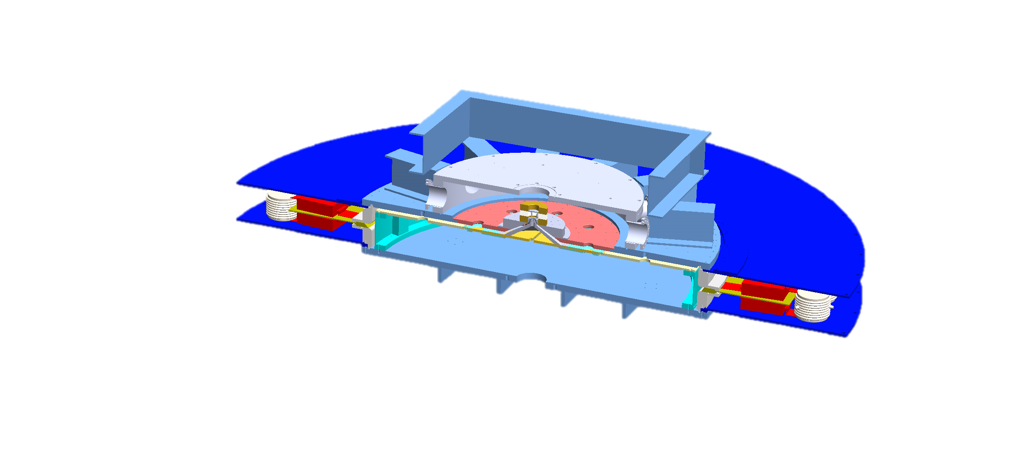
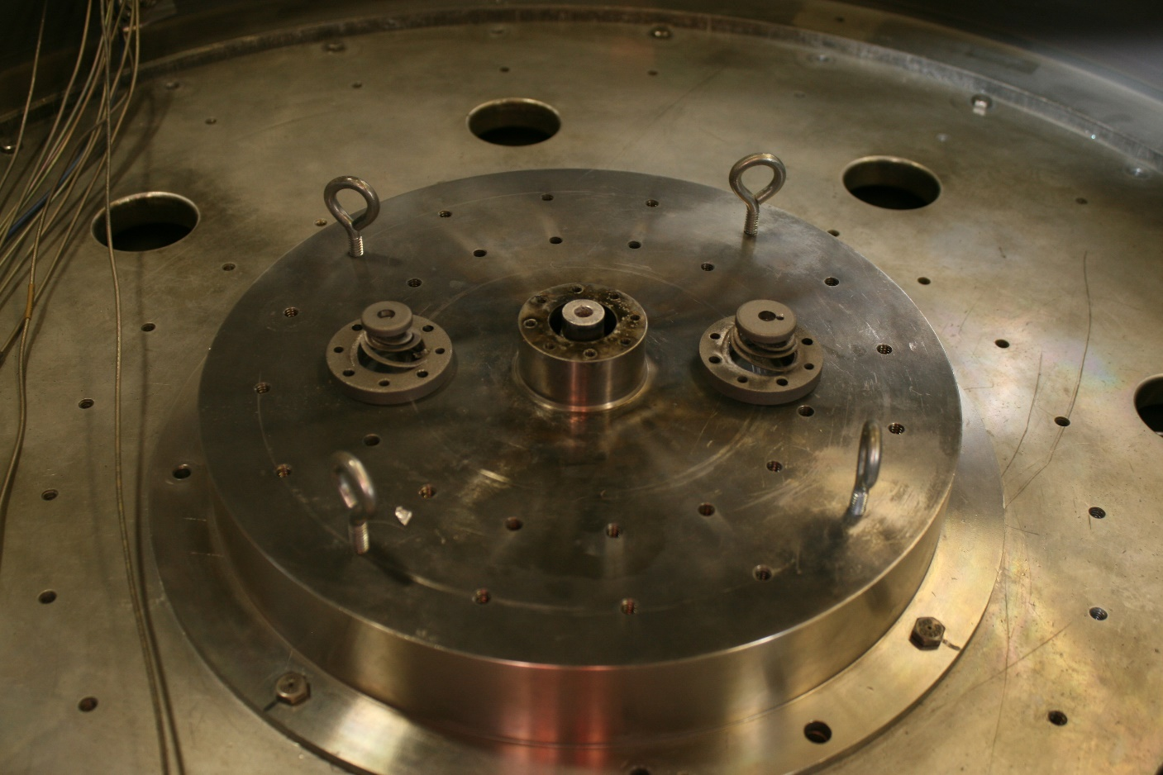
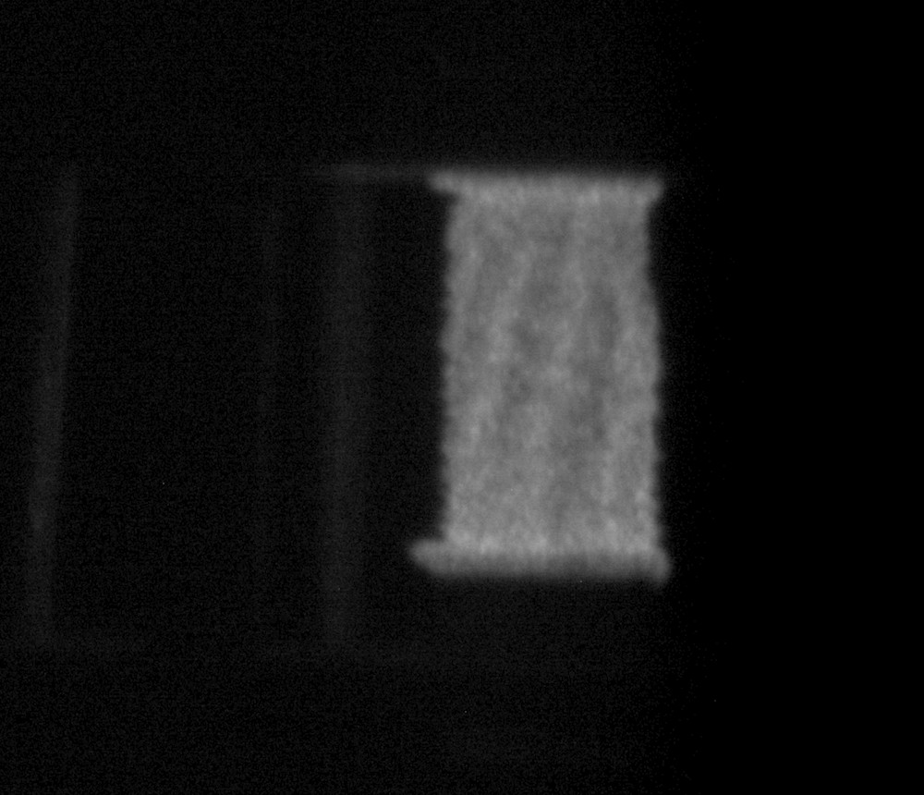
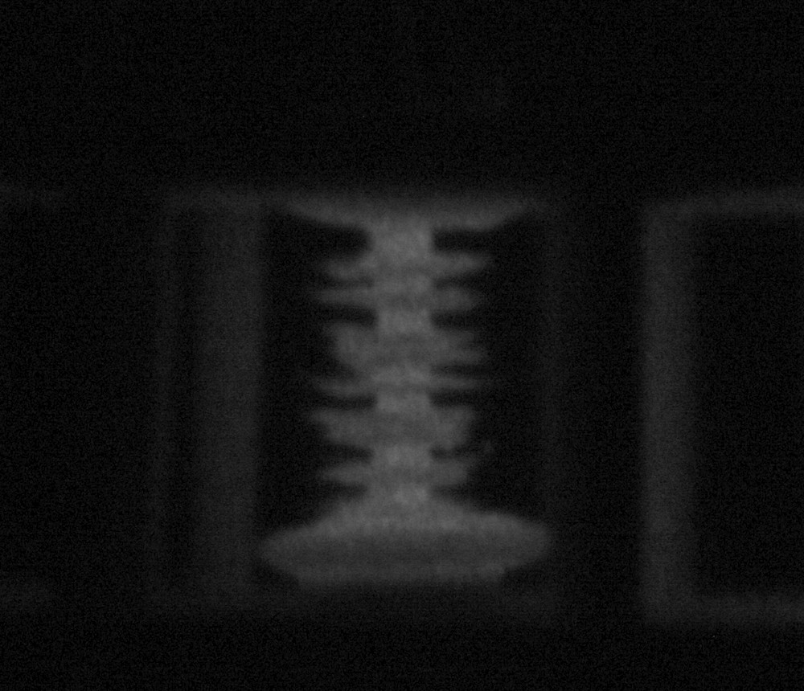
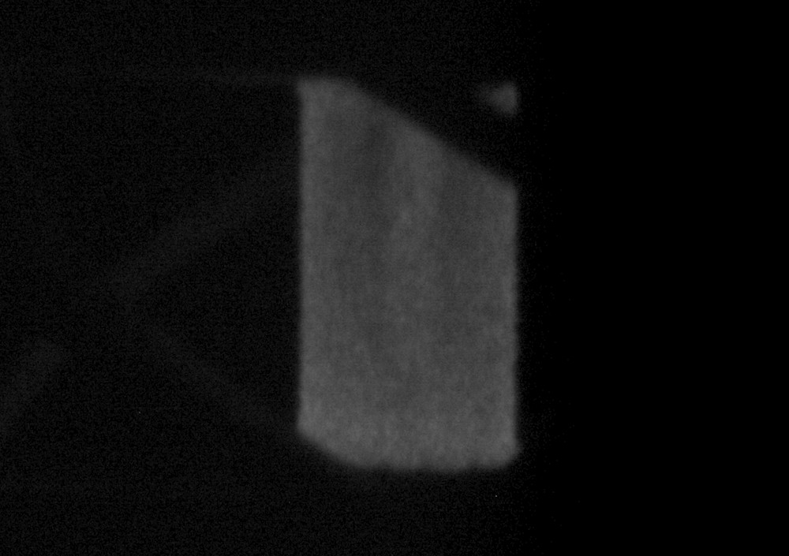
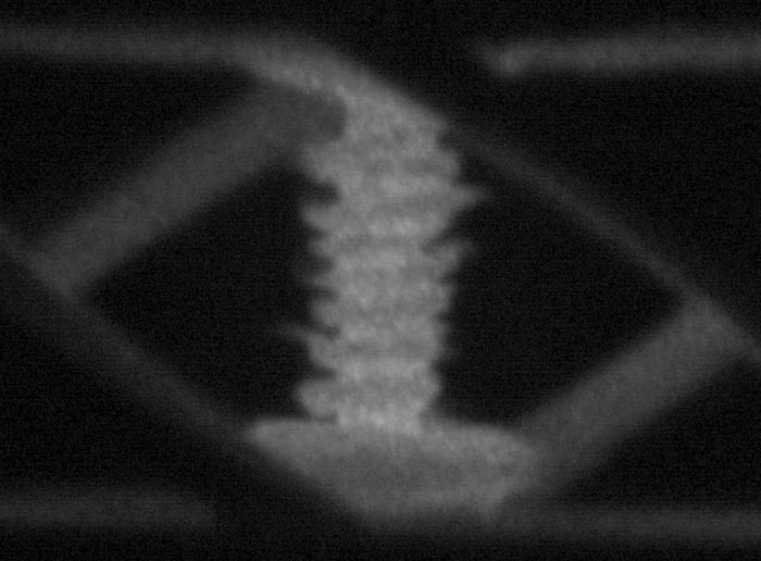
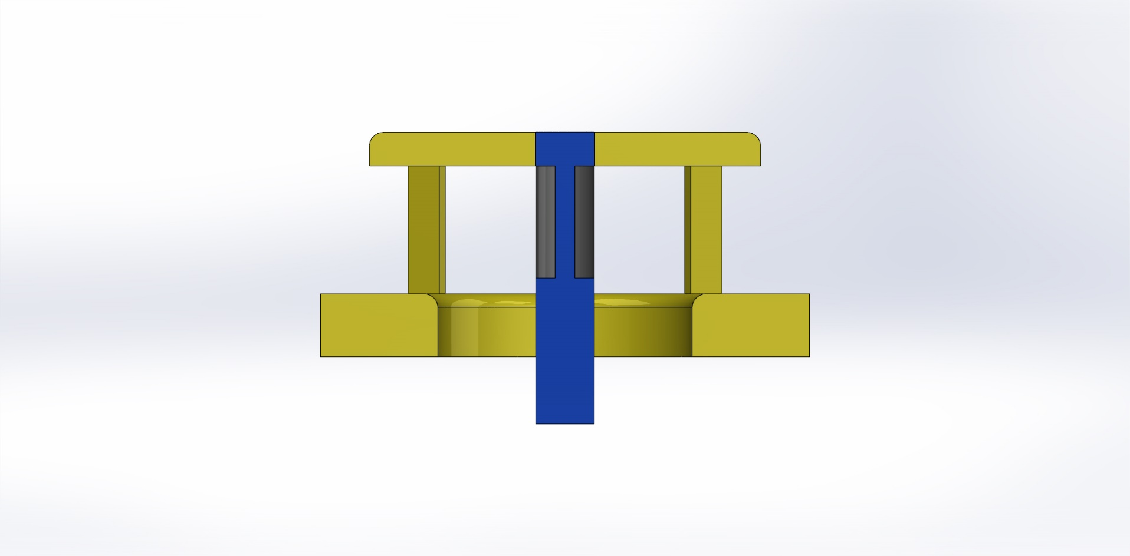
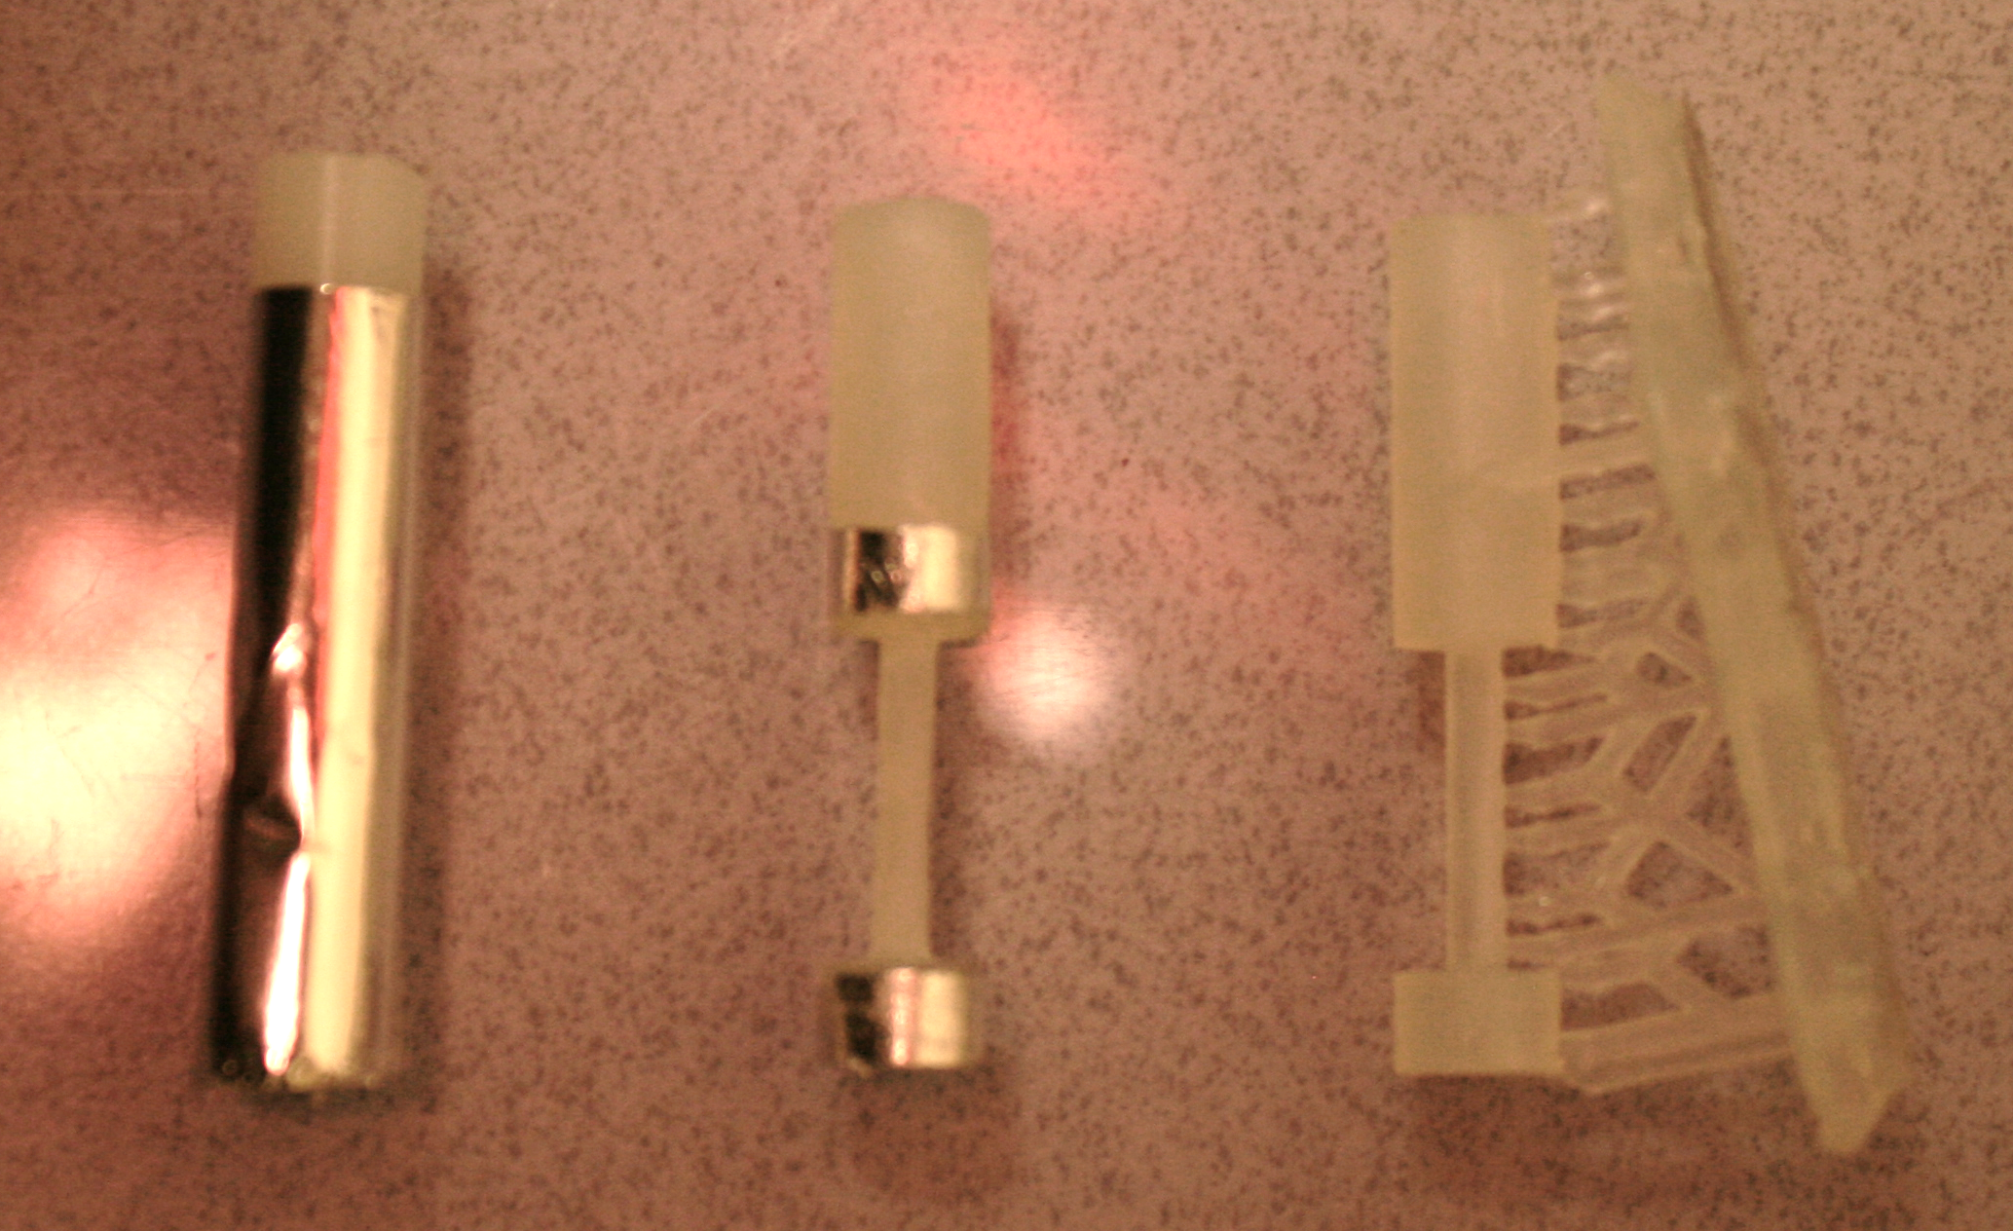
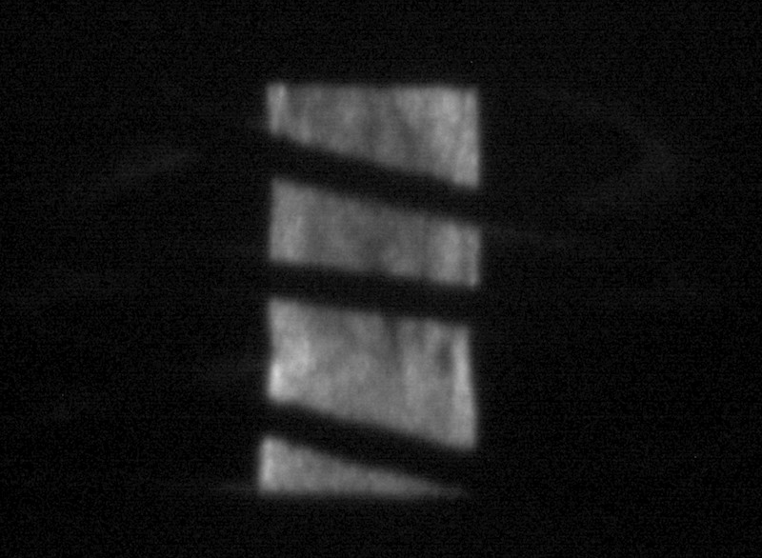
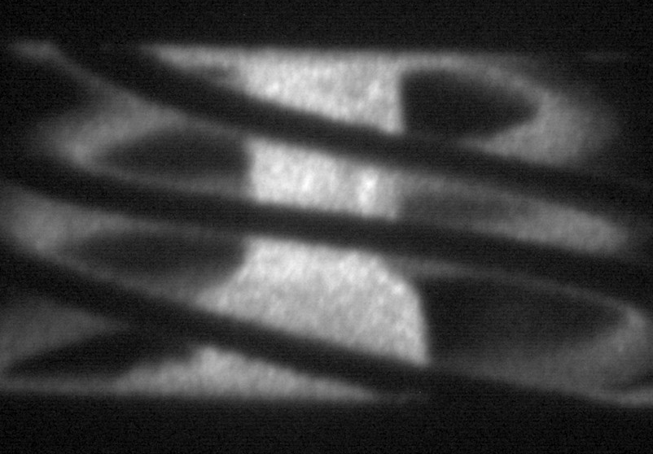
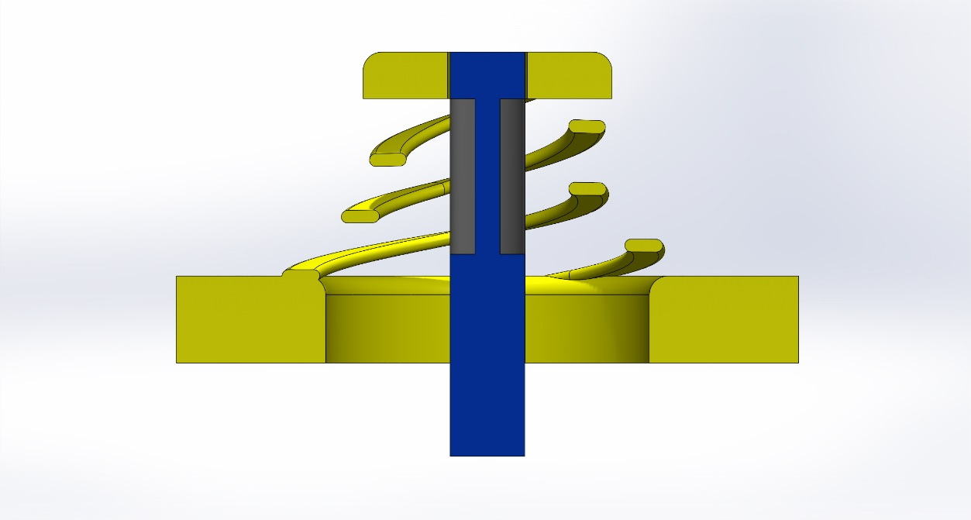
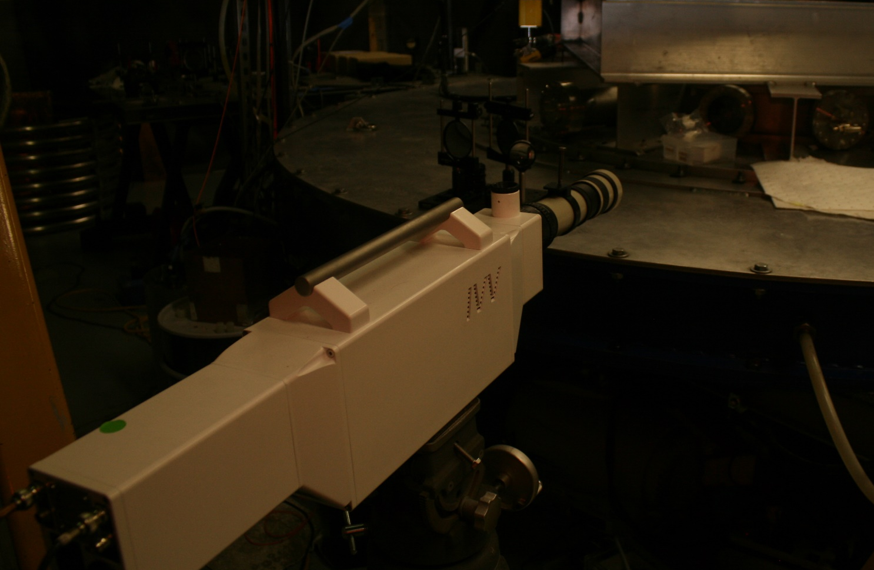
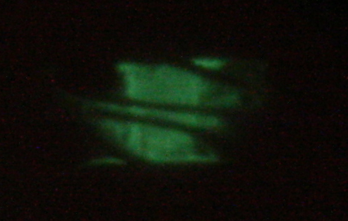
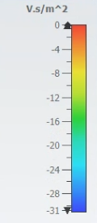
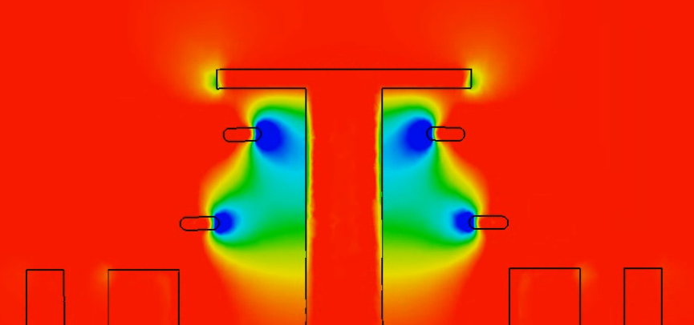






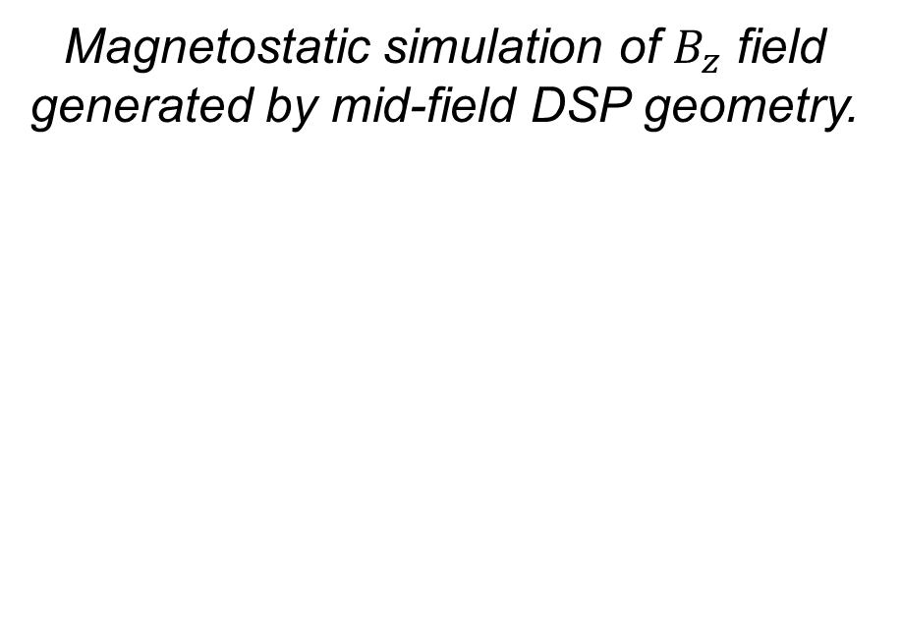
Stability Analysis of Dynamic Screw-Pinch Driven Thin-Foil Liner Implosions on MAIZE
A. Bedel, J. Chen, L. Tafoya, N. M. Jordan, and R. D. McBride
Nuclear Engineering and Radiological Sciences, University of Michigan
MAIZE Linear Transform Driver
Experimental Setup / Preliminary Analysis
The Michigan Accelerator for Inductive Z-Pinch Experiments (MAIZE) at the University of Michigan is an efficient, single-cavity Linear Transform Driver (LTD). MAIZE is capable of outputting a peak current of up to 1 MA with a rise time ≈ 150 ns. During each experiment, nearly 10 kJ of energy are stored across 40 pairs of capacitors (bricks) along the outer portion of the LTD’s 3m diameter. This geometry minimizes inductance, and allows fast delivery of energy to a central load.
A total of 24 high-current shots were conducted across the three DSP and single standard Z-Pinch geometries.
Analysis was intended to focus on instability growth rate, extracting instability amplitude as a function of average distanced moved, as referenced in [2].
This analysis was found to be impossible for all but the low-field DSP case, as axial compression was observed to be significantly impeded in the mid-field and high-field geometries across multiple shots, despite similar peak-current values.
For the standard Z-Pinch geometry, large m=0 instabilities were observed, with a growth rate that grew as a function of 1/r, as expected.
For the low-field DSP case, helical instabilities were driven with a pitch angle $θ$ equal to the initial drive-field ratio (DFR):
$$θ=arctan\left(\frac{B_{z}}{B_{θ}}\right)$$
The helical instability structure from the low-field DSP case grew significantly slower than m=0 instability from the standard Z-Pinch case, due to a time-varying drive-field ratio:
$$θ=\arctan\left(\frac{μ_{0}I\left(t\right)}{2πr\left(t\right)}÷CI\left(t\right)\right)$$
3D cross-section of MAIZE
Although MAIZE has the capability and history to conduct experiments across a wide range of experimental geometries, including a Dense Plasma Focus [1], Gas-Puff Z-Pinch [2], Exploding Wire-Array, and X-Pinch, its “standard” configuration and focus of this poster is of the Fast Z-Pinch.
Interior of MAIZE target chamber with mid-field (right) and high-field (left) DSP return current structures.
35 mm
In a fast Z-Pinch implosion, a strong current is passed through a hollow cylindrical liner, producing an azimuthally symmetric magnetic field $B_{θ}=μ_{0}I/2πr$. The current rapidly heats and ionizes the initially-solid liner while the B-field sets up a magnetic pressure gradient across the liner, accelerating the recently-formed plasma radially inward. After a brief imploding period, the plasma stagnates on axis, reaching extreme temperatures and pressures.
Current
Path
Liner
Anode
Cathode
Standard Z-Pinch Return Current Geometry
Motivation for Dynamic Screw-Pinch
Thin-Foil Liners are too fragile to be freestanding, so 3D-printed dumbbell support structures are utilized.
Z-Pinch plasmas form the basis for Magnetized Liner Inertial Fusion (MagLIF) but are susceptible to the fast growing magneto-Raleigh-Taylor instability (MRTI) and to current-driven magneto-hydrodynamic (MHD) instabilities in general. These instabilities reduce energy coupling to the target and detrimentally impact fusion yield. One proposed MRTI mitigation technique is to use a Dynamic Screw-Pinch (DSP) return current structure, which generates a helical magnetic field with a time-varying pitch angle to drive the implosion. Recent numerical simulations [1] and experimental results [2] suggest that a DSP can effectively stabilize a z-pinch to MRTI and MHD instabilities, and stabilization increases as a function of the initial drive-field ratio.
Standard Z-Pinch (top), low-field DSP (middle) and mid-field DSP (bottom) shown early in time and during implosion stagnation.
Diagnostics
Conclusions & Future Work
Anode
The current pulse delivered to the load on MAIZE is measured using a 40cm Rogowski coil surrounding the power feed. A 12-frame visible-spectrum fast framing camera (FFC) was used with a 4-frame XUV self-emission imaging system to diagnose MRTI growth. The XUV system consists of four, 200 µm pinholes coupled to four micro-channel scintillating plates, which are in turn imaged with a long exposure camera. Further diagnostic development will include <1cm micro b-dot probes placed within the return current structures and inside the thin-foil liner to diagnose the timing of magnetic advection.
The low-field and mid-field DSP designs suppressed MRT instability growth significantly when compared to a SZP.
The failure of the high-field DSP to achieve significant compression is evidence of a significant diffusion of axial magnetic field through the outer liner early in time.
Cathode
Dynamic Screw-Pinch Return Current Geometry
Initial drive-field ratios, defined as the ratios between the DSP imposed axial magnetic field and the current-driven azimuthal field before compression, have been experimentally tested with values between 2.8% to 28%. These values are functions of the DSP return-current structure geometry. This study extends the experimental work by testing three new DSP geometries, with initial drive-field values of 5.5%, 39%, and 77% with the purpose of finding a possible upper-limit to the stabilizing effects of the time-varying axial magnetic field produced by a DSP. The initial drive-field ratios for the new geometries were calculated using magneto-static simulations and have similar inductance values.
Cartoon diagram depicts flux compression of $B_{z}$ by Z-Pinch plasma
Future experimental work will be aimed at using micro B-dot probes to measure the axial field on the interior and exterior of the DSP plasma in order to diagnose the rate and timing of hypothesized magnetic diffusion.
Simulation efforts, which have formerly been targeted towards thick-shelled MagLIF-like implosions, will be used to validate experimental findings
Magnetostatic simulation of $B_{z}$ field generated by mid-field DSP geometry.
Visible spectrum 12-Frame fast framing camera
XUV image of mid-field DSP implosion with gas blow-off
[1] G. A. Shipley et al., “Numerical study of implosion instability mitigation in magnetically driven solid liner dynamic screw pinches” Physics of Plasmas 31 (2), 022704 (2024)[2] N. Friedman, "The Naval Institute Guide to World Naval Weapon Systems", 5th ed. Naval Institute Press, 2006.
[2] P. Campbell et al., “Stabilization of Liner Implosions via a Dynamic Screw Pinch” Physical Review Letters 125, 035001 (2020)[4] E. C. Okress. “Microwave Power Engineering: Generation, Transmission, Rectification”, Volume 1. Academic Press. 1968.
This work was supported by the joint program between the National Science Foundation (NSF) and the National Nuclear Security Administration (NNSA) under NSF Grant No. PHY-2205608 and by the Center for Magnetic Acceleration, Compression, and Heating (MACH), part of the NNSA's Stewardship Science Academic Alliances Program under DOE Cooperative Agreement DE-NA0004148.

